Slide 1
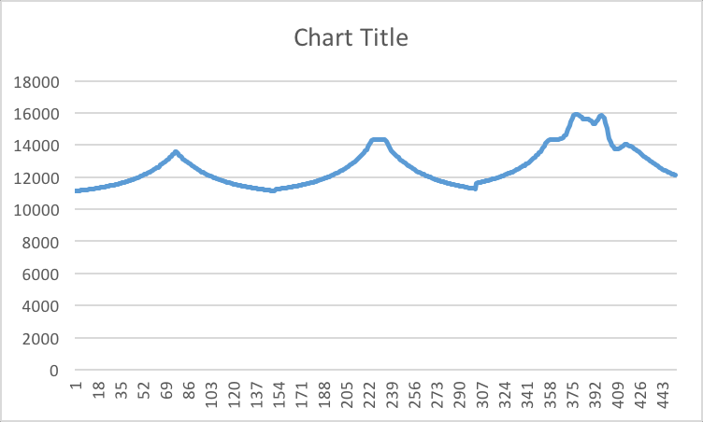
Is this what you are inputting as training data?
LOAD
UNLOAD
LOAD
UNLOAD
LOAD
UNLOAD
5 N
50 N
1 N

Slide 2
Garbage in means Garbage out
You have help yourself a little because garbage in means garbage out
You cannot just concatenate your different files and hope to have a good result.
You have to first detrend the data – there is a drift that shows up over time between the load trials that is resulting in the discontinuity (see pt 307)
You have to establish over the load-unload cycle for different loads that the system returns to where it started (no hysteresis) – this is one of things we have to show for a good sensor.
If you calibrate you data and work in N and m and not counts and bits this drift between trials would be calibrated out.
Rather than LSE use rmse and present an R^2 value also.

Slide 3
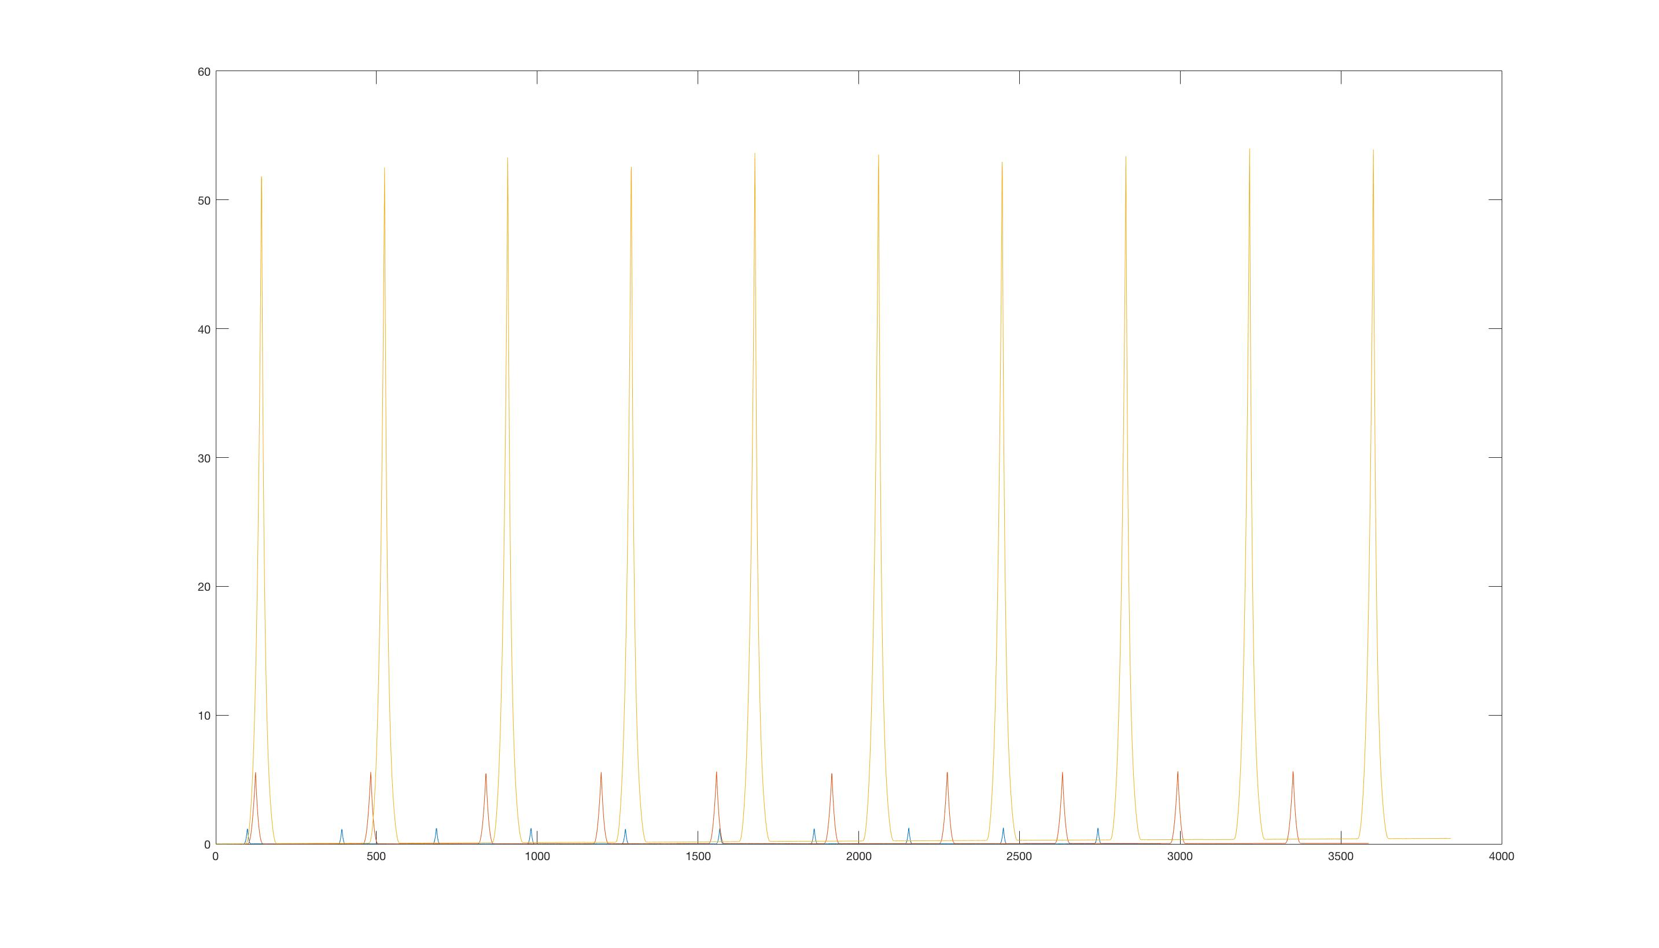
Force (N)

Slide 4
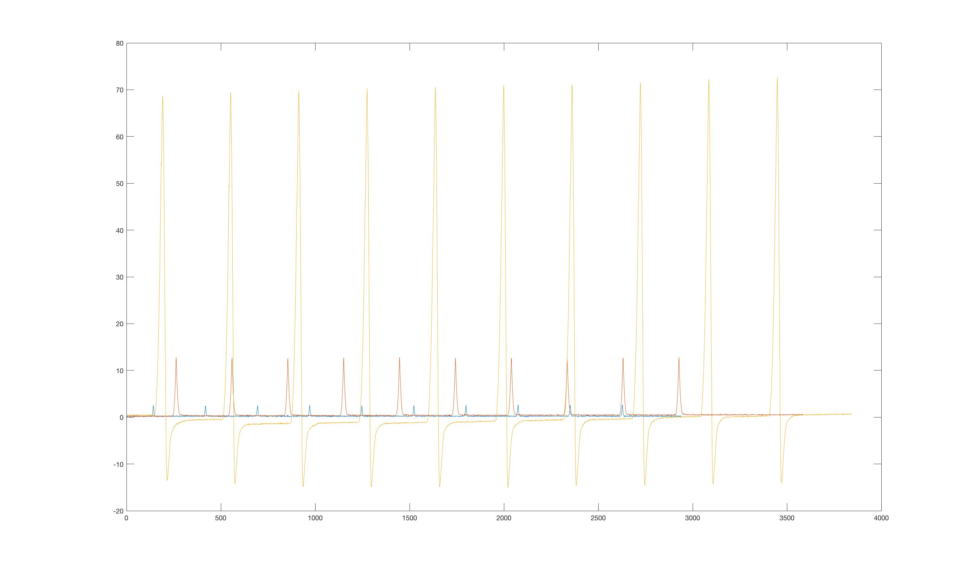
Baro

Slide 5
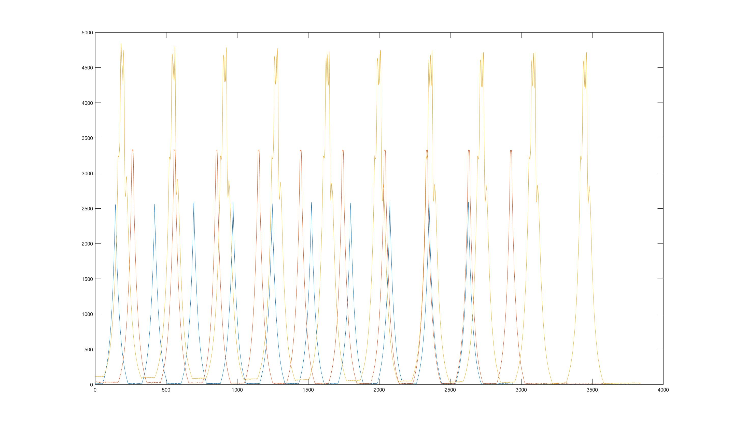
IR

Slide 6
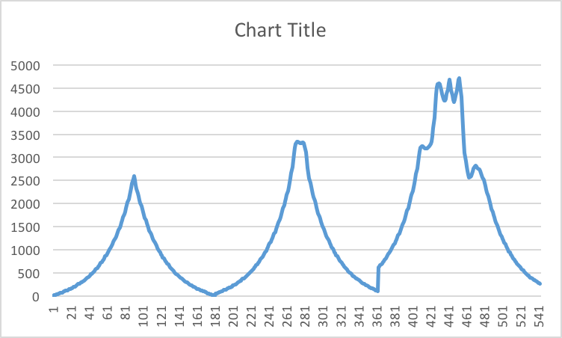
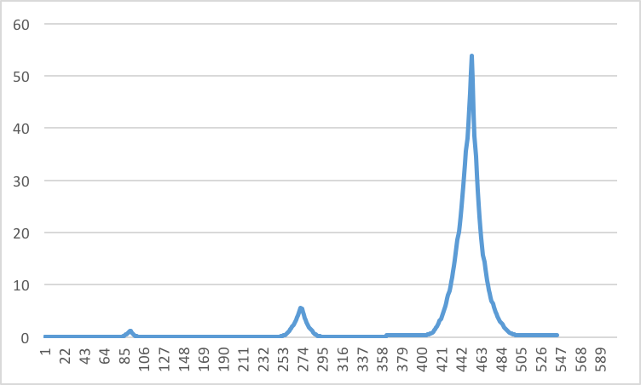
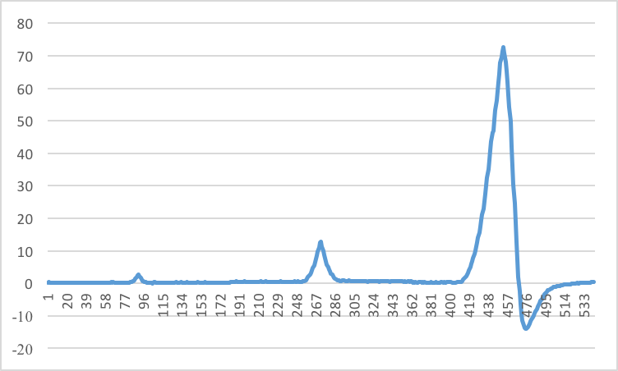
IR
Force(N)
Baro

